Slide 1
TEAM 1 PRESENTATION
COMP-3220
BY: Blake Derksen, Hiba Rehman, Karanveer Sidhu, Matthew Gagnon, Matthew Muscedere, Tory Provenzano, Varunteja Katakam

Slide 2
OUR CASE WE CHOSE, OUR VISION
Our team chose: “Case Study 6: COVID-19 Datasets from CMAJ”
The article provided in the case study highlighted a critical need for timely, accurate, and accessible epidemiological data during a health crisis, which was lacking during the recent COVID-19 pandemic.
The case study also provided us with links to a GitHub repository and a dashboard to reference when creating our own platform to display COVID-19 data.
Our objective was to create an open data platform that uses the data provided by these resources to create and manage one source for all COVID-19 case data in Canada. Our primary vision was to facilitate easy access to high-quality, real-time epidemiological data to improve public health responses, speed up research, and encourage innovation.

Slide 3
REQUIREMENTS, SCOPE, AND RISKS
Requirements/Scope:
Interactive dashboards to display COVID-19 data.
Real-time updating of datasets by public health authorities.
Enable developers/researchers to access data publicly.
Main Risks:
Data privacy problems, including data leaks and illegal access.
Maintaining data integrity and accuracy.
Scheduling risks, like scope creep and time conflicts.

Slide 4
SOLUTIONS
Some solutions that we produced to mitigate these risks are:
Limit access to datasets and our repositories, insuring data privacy.
Implement data validation checks and provide error handling for incomplete data sets, insuring data integrity and quality.
Set up meetings a week ahead of time to ensure everyone is on the same page, and to strictly follow our inception plan to not have too much work.
Giving everyone a role/job in an assignment, optimizing our workflow and ensuring full completion of a part/section.

Slide 5
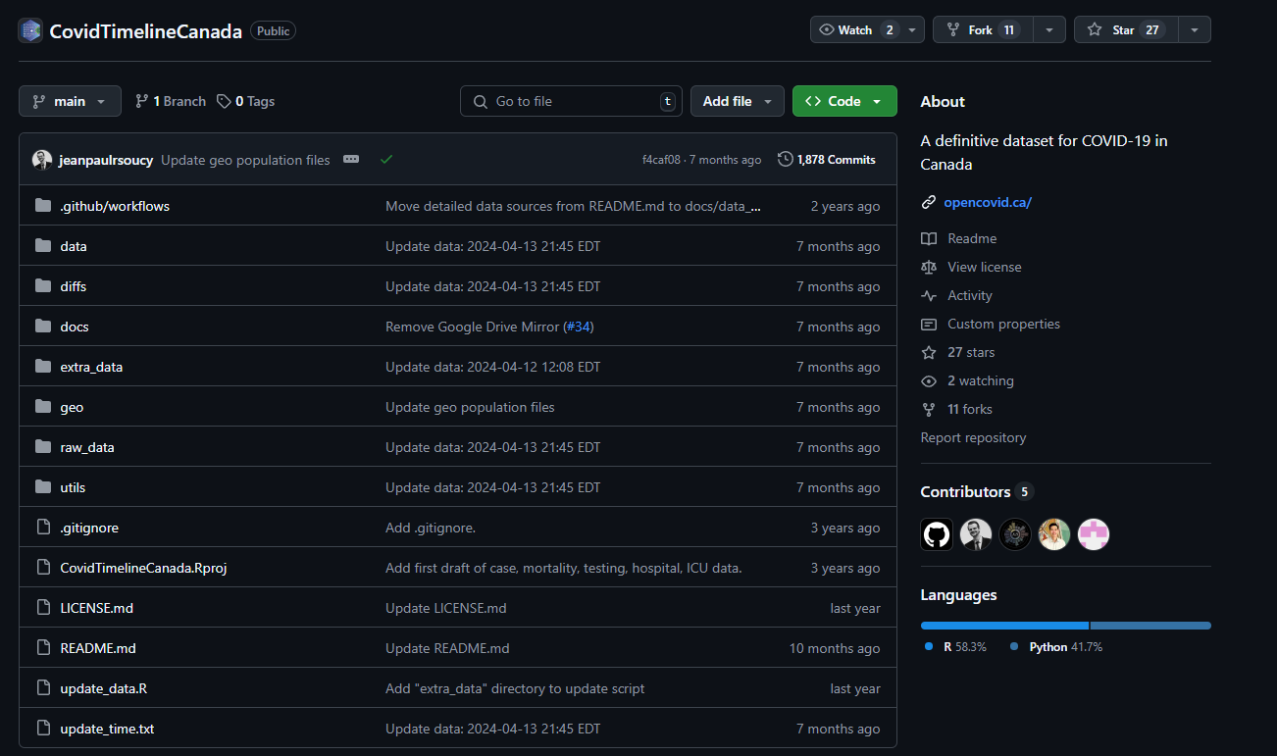
HOW WE USE OPEN DATA
Aggregating and analyzing COVID-19 statistics, including cases, recoveries, and vaccine distributions, across Canadian provinces.
Parsing data from publicly available CSV files and validating it for accuracy.
Processing the data into interactive visualizations and tables for user exploration.
Allowing users to filter data by region and timeframe to uncover trends and insights.
Building APIs for developers to integrate data into their own applications, fostering innovation.
Providing a platform that leverages open data to enhance public health decision-making.

Slide 6
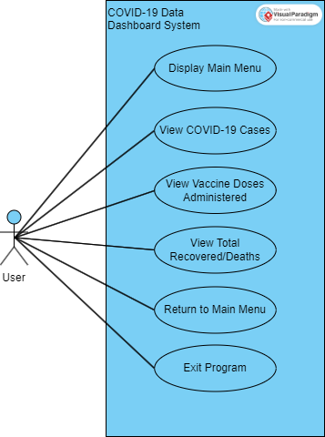
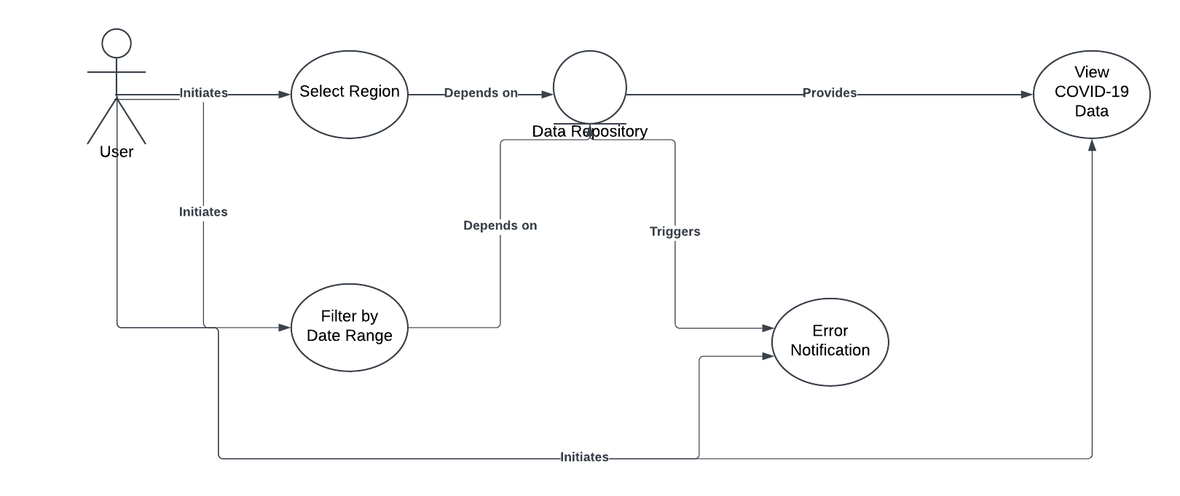
APPLICATION DESIGN/ARCHITECHTURE
Here is an early UML diagram we used to create our first iteration of our program. This use case shows the different menus we wanted to incorporate, while leaving room for expansion and different types of users.
Here is another use case diagram showing an idea on how we can iterate on our program, adding features like filters, error notifications, region selecting.

Slide 7
HELPFUL OO DESIGN PATTERNS
Some of the OO design patterns that we implemented within our code are:
Low Coupling: minimized dependencies between classes.
Information Expert: classes that are responsible for managing/fulfilling a specific task.
Controller: delegates responsibilities for handling system events/use cases/interactions to a class.
High Cohesion: each class having a specific, focused responsibility.
Creator: identifying a class that is responsible for instantiating another class.

Slide 8
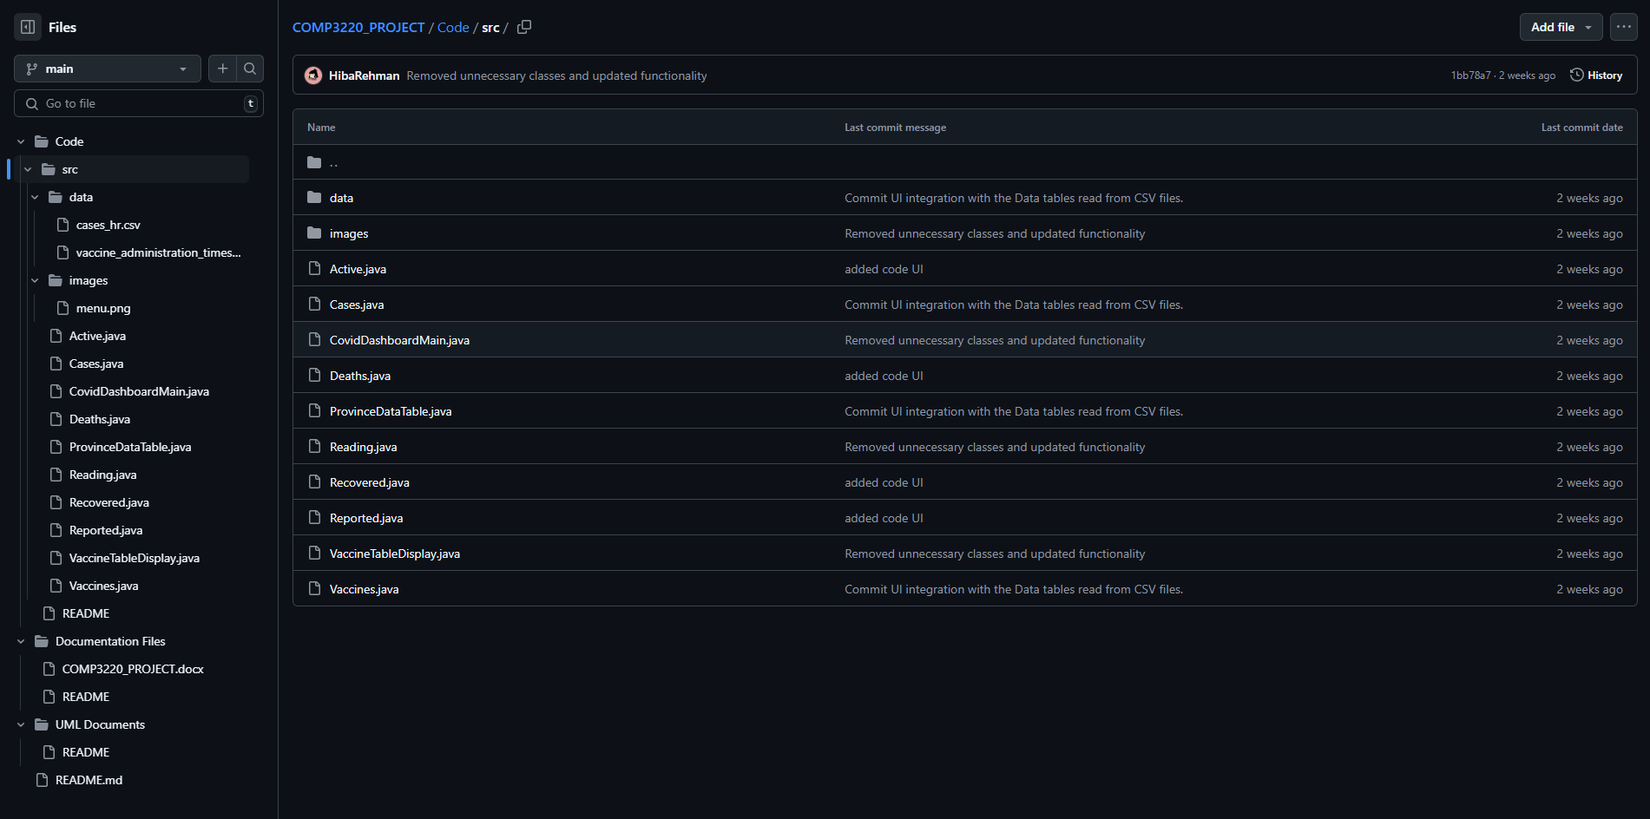
MAIN SOFTWARE/APPLICATIONS USED
Communication: Microsoft Teams
Documentation: Microsoft Word
Presentation: Microsoft PowerPoint
UML: Lucid Chart and Visual Paradigm
Coding: Visual Studio Code, Overleaf, JFrame
Repository: GitHub
Prototyping: Figma

Slide 9
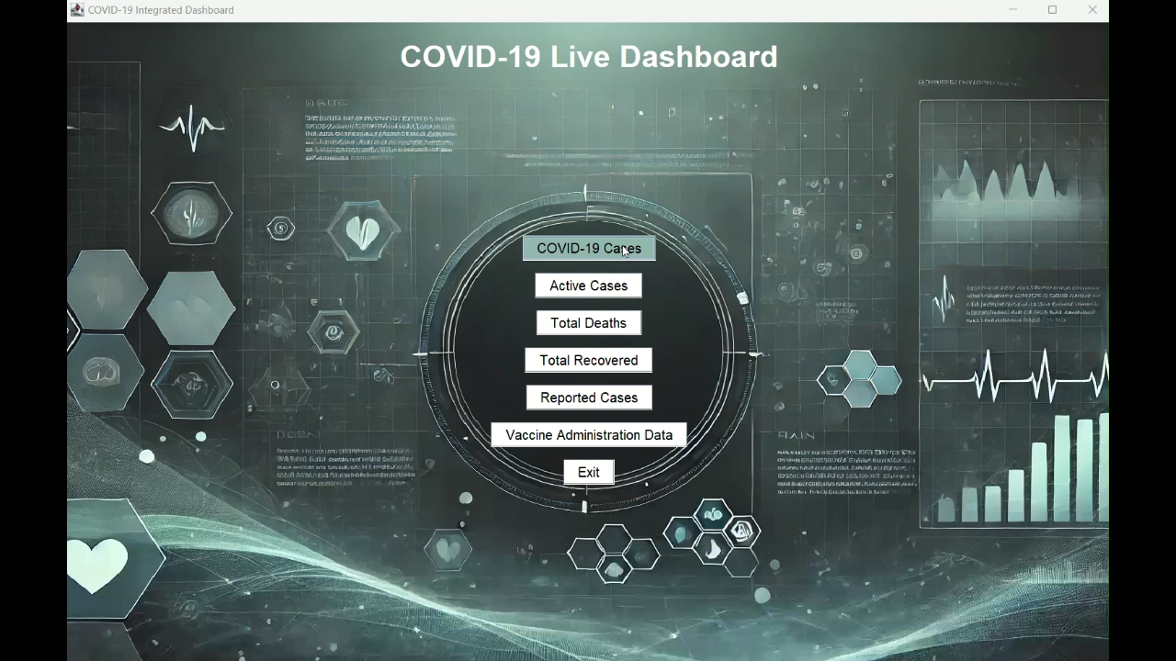
SAMPLE/DEMO OF APPLICATION

Slide 10
NEXT ITERATION PLAN
Some plans and key goals for our next iteration are:
Enhance the UI developed in the last phase and more visual elements, features, and make it more visually appealing.
Implement more use cases for different sets of people, with different interactions and functionalities, making UML diagrams to reference.
Refine backend file management and bug fixing, testing more often as more features are added.
Update UML diagrams and case documentations to reflect the newest version and vision of the project.

